Slide 1
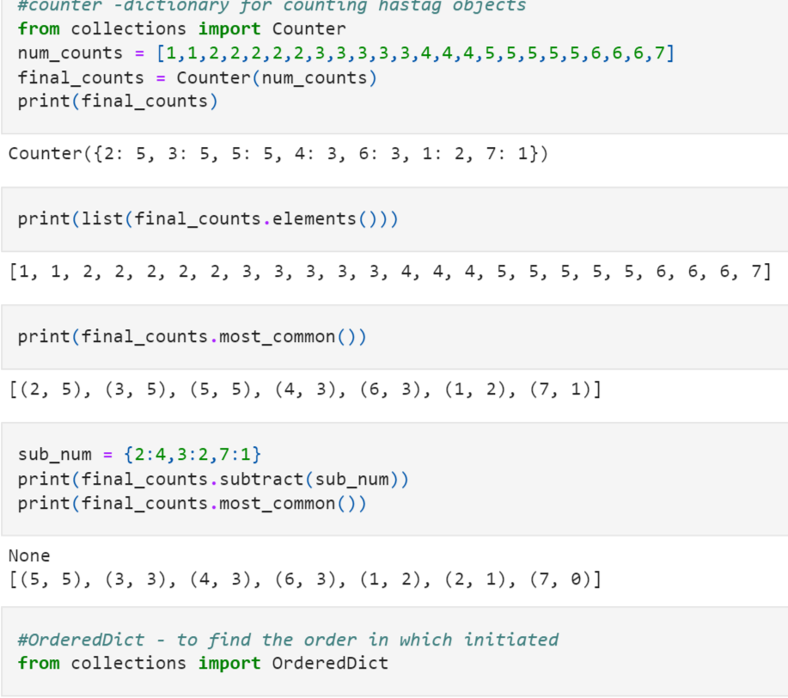

Slide 2
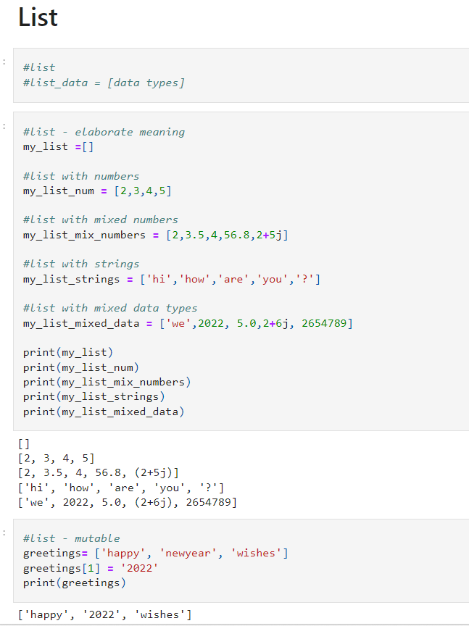

Slide 3
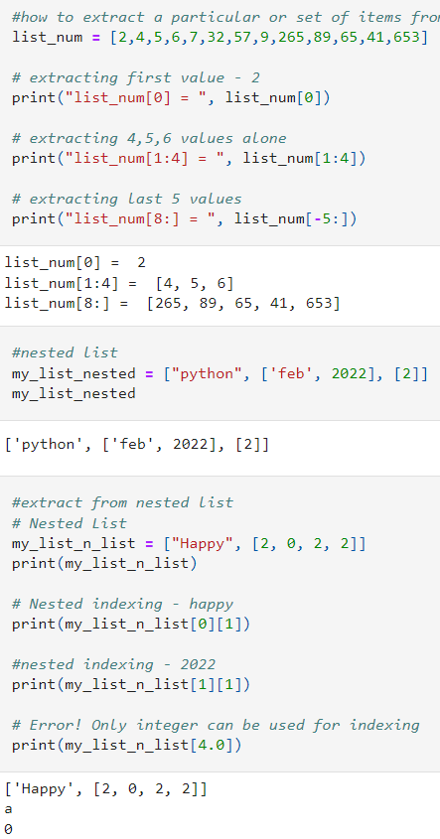
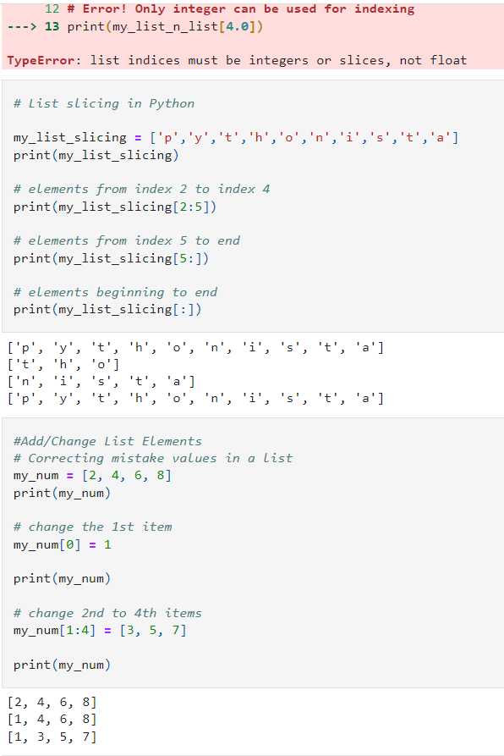
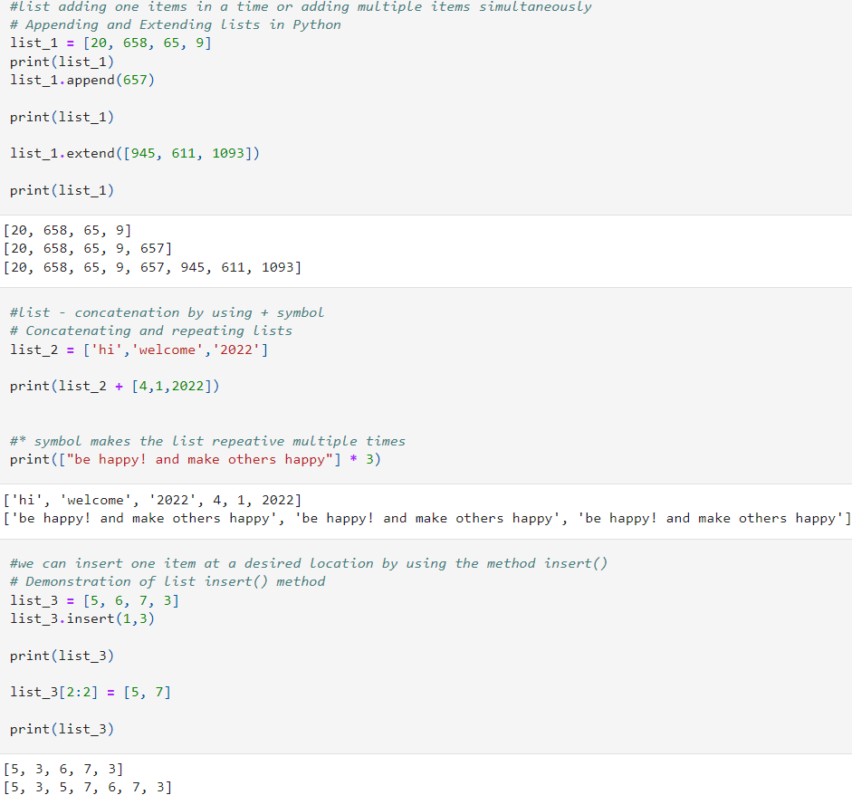

Slide 4
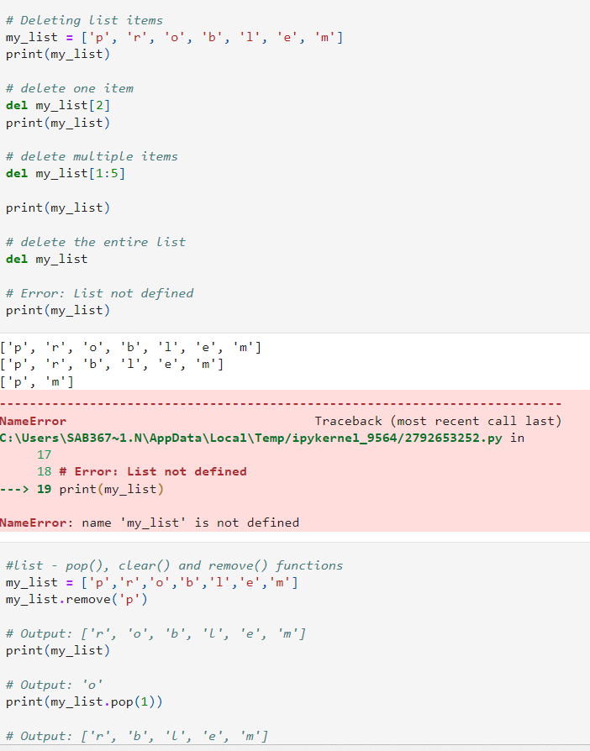
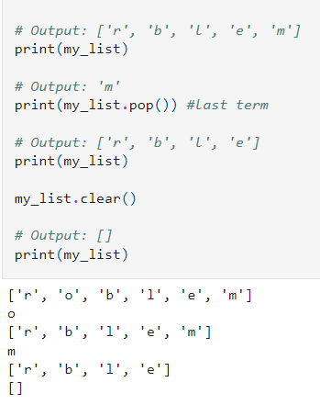

Slide 5
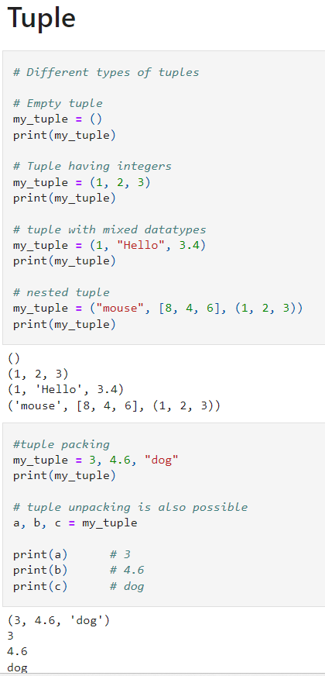
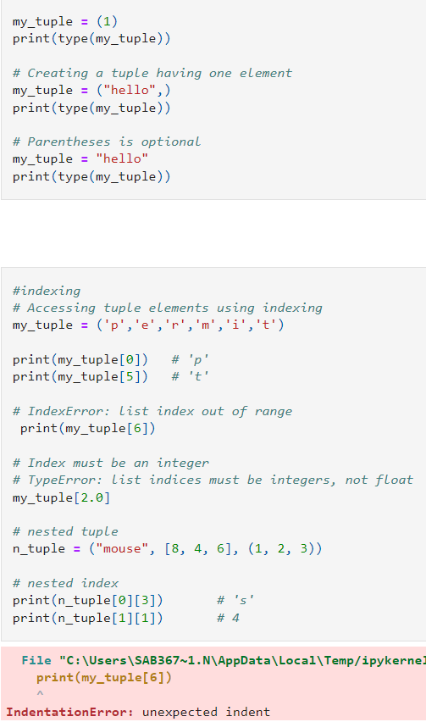
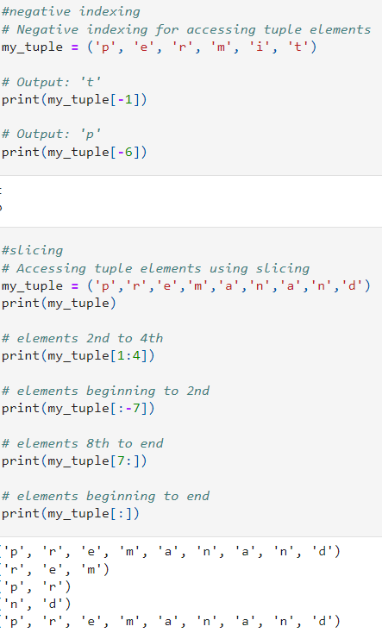

Slide 6
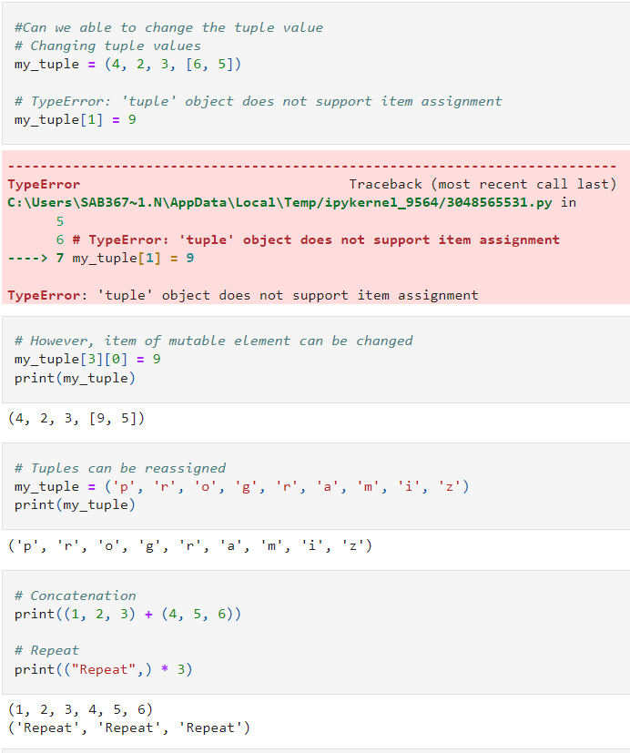
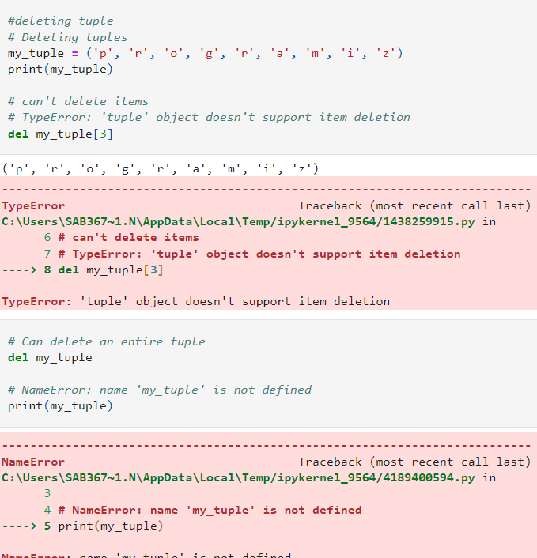

Slide 7
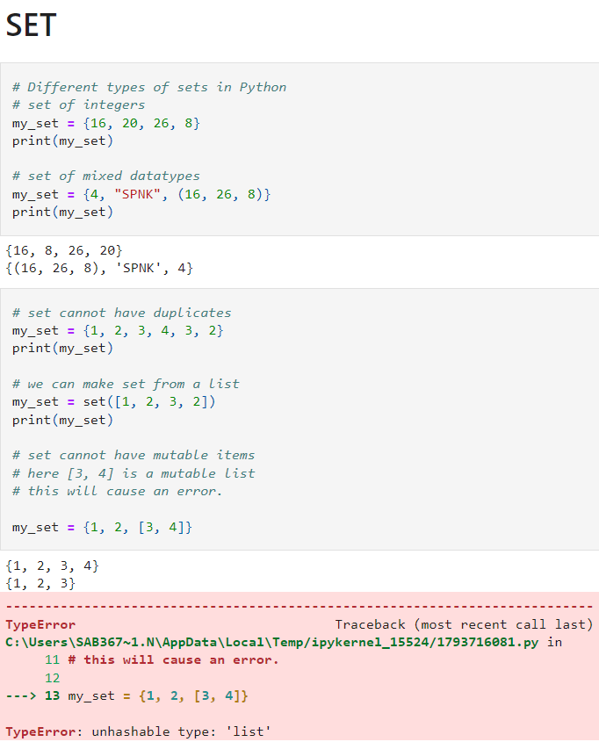
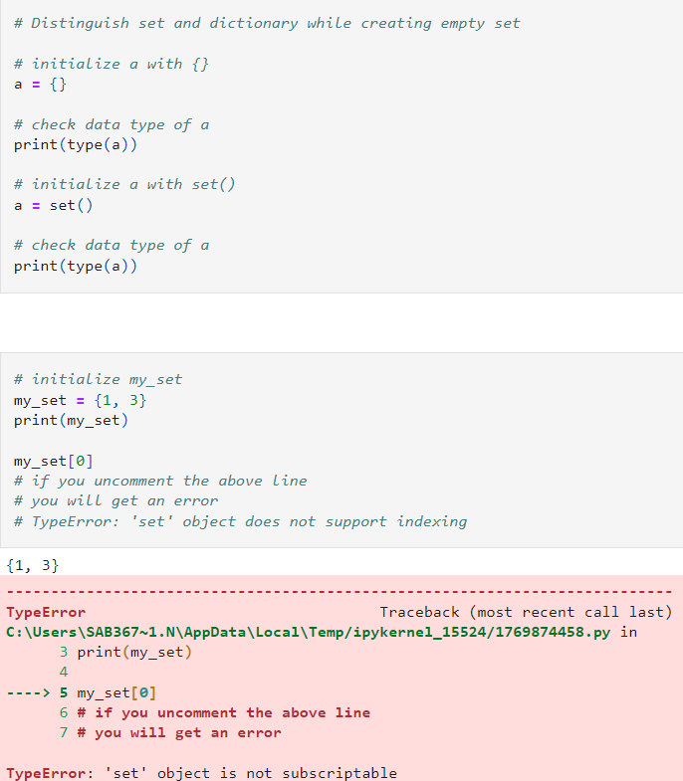

Slide 8
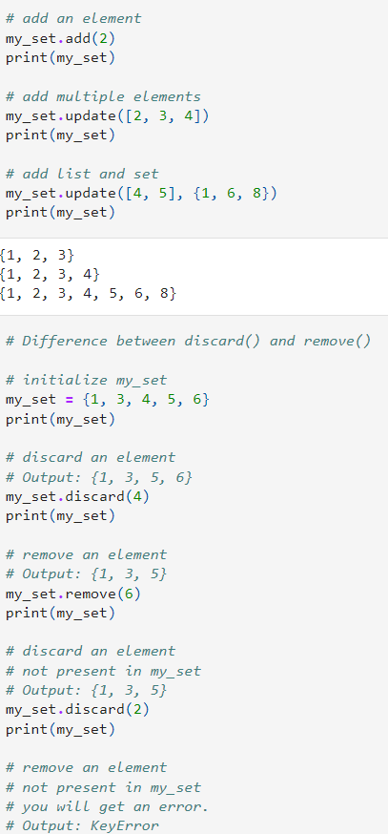
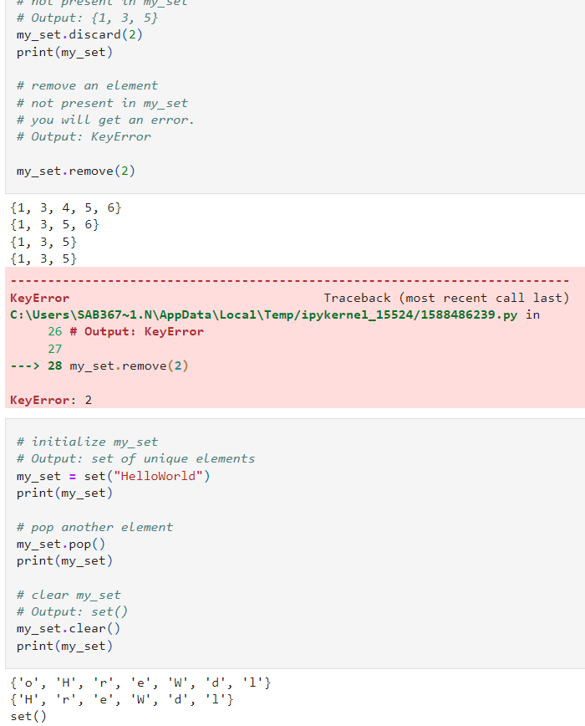
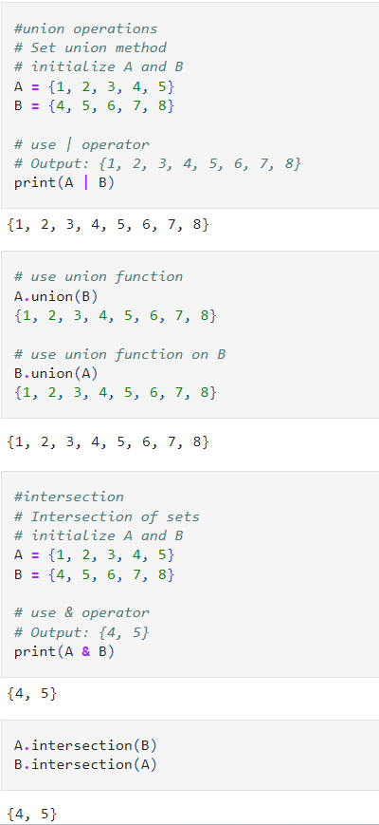

Slide 9
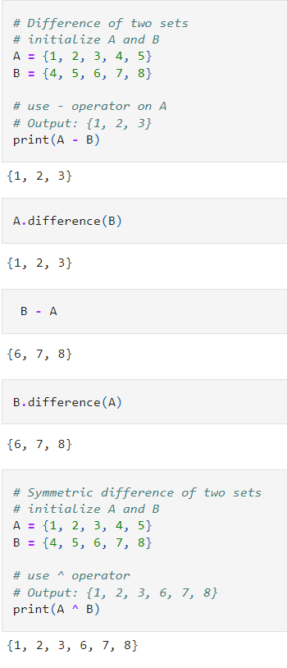
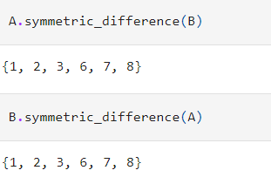

Slide 10
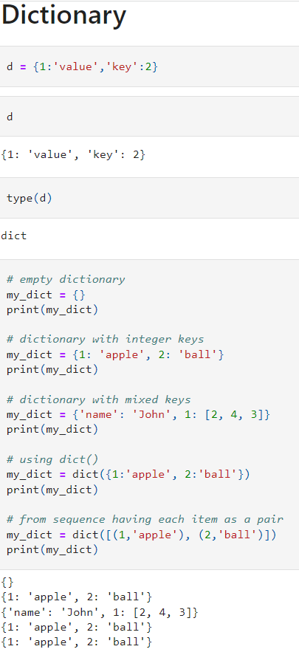
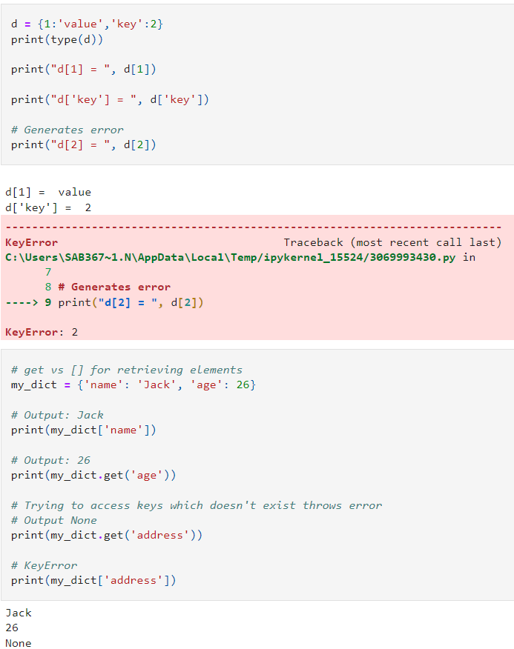
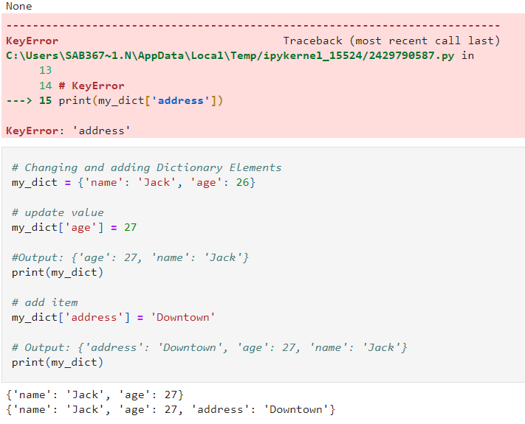

Slide 11
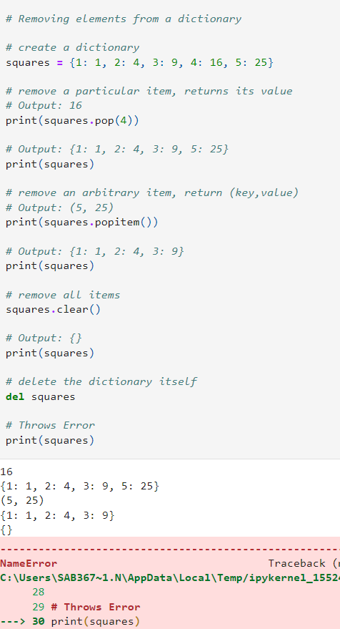
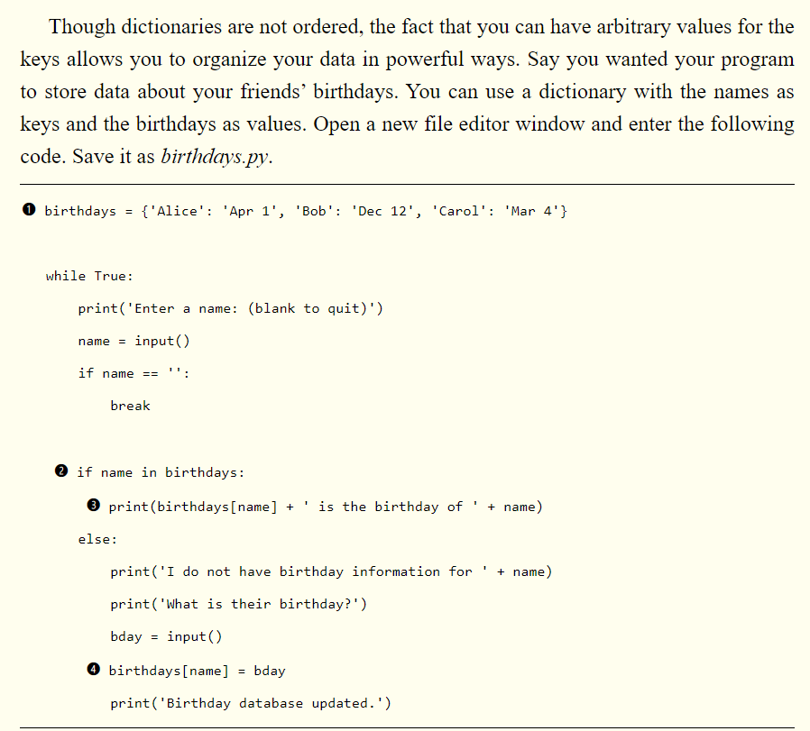

Slide 12
message = 'It was a bright cold day in April, and the clocks were striking thirteeb.'
count = {}
for character in message:
count.setdefault(character,0)
count[character] = count[character] + 1
print(count)

Slide 13
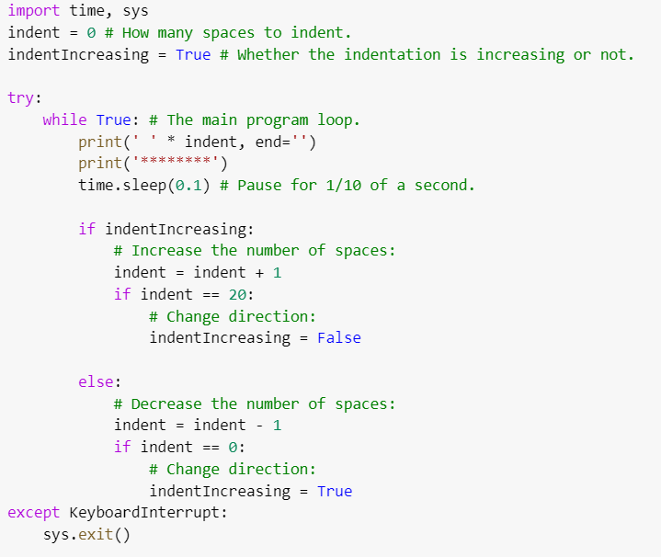

Slide 14
Justifying Text with the rjust(), ljust(), and center() Methods
def printPicnic(itemsDict, leftWidth, rightWidth): print('PICNIC ITEMS'.center(leftWidth + rightWidth, '-')) for k, v in itemsDict.items(): print(k.ljust(leftWidth, '.') + str(v).rjust(rightWidth)) picnicItems = {'sandwiches': 4, 'apples': 12, 'cups': 4, 'cookies': 8000} printPicnic(picnicItems, 12, 5) printPicnic(picnicItems, 20, 6)
---PICNIC ITEMS-- sandwiches.. 4 apples...... 12 cups........ 4 cookies..... 8000 -------PICNIC ITEMS------- sandwiches.......... 4 apples.............. 12 cups................ 4 cookies............. 8000

Slide 15
Partition(at word),split(at gaps into list),join(list into string)
Removing Whitespace with the strip(), rstrip(), and lstrip() Methods
>>> spam = ' Hello, World ' >>> spam.strip() 'Hello, World' >>> spam.lstrip() 'Hello, World ' >>> spam.rstrip()
>>> spam = 'SpamSpamBaconSpamEggsSpamSpam' >>> spam.strip('ampS’)# in place of amps we can use maps or spam output:'BaconSpamEggs'

Slide 16
Numeric Values of Characters with the ord() and chr() Functions

Slide 17
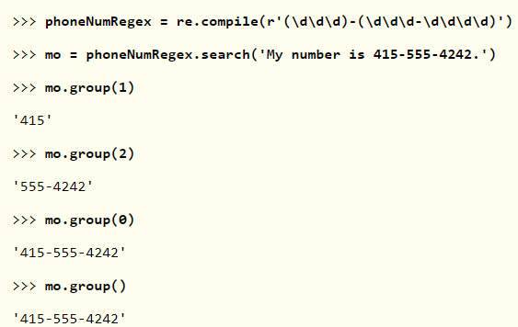
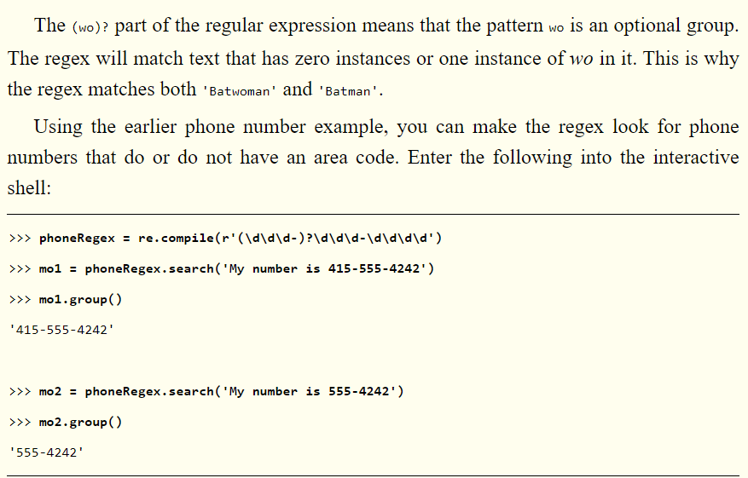
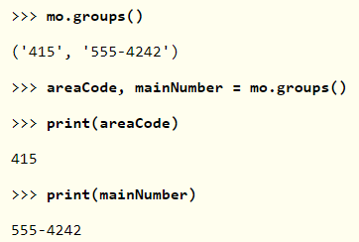
REGULAR EXPRESSION

Slide 18












https://automatetheboringstuff.com/

